Slide 1
Problems
Modern Physics: Nuclear Energy Sources
by
Dr. J. V. Thombare,
Assistant Professor,
Department of Physics,
Vidnyan Mahavidyalaya, Sangola.
E-mail-jagannaththombare@gmail.com

Slide 2
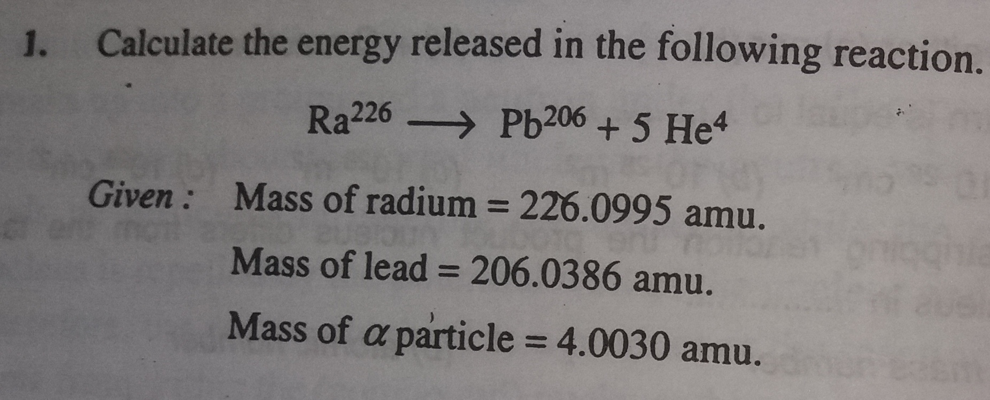

Slide 3
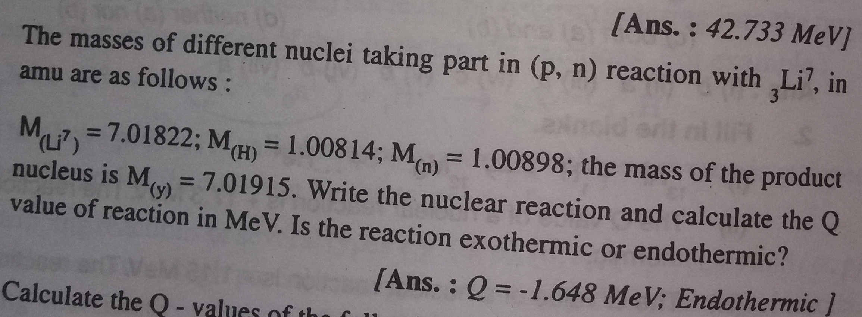

Slide 4
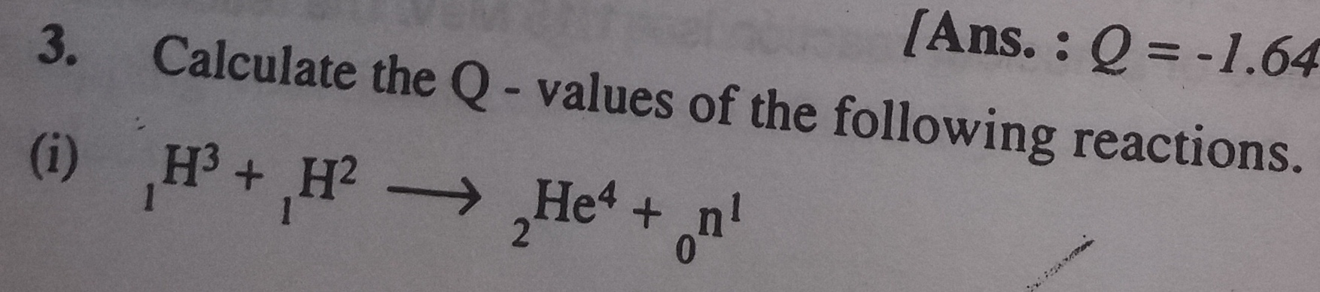
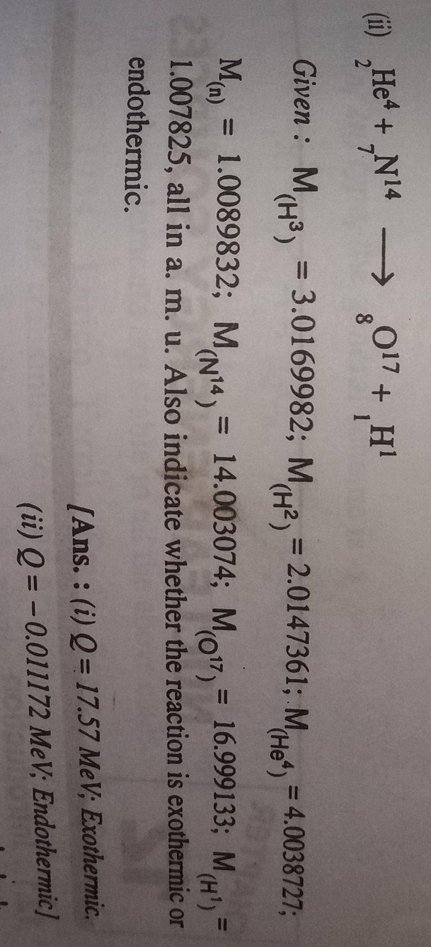

Slide 5
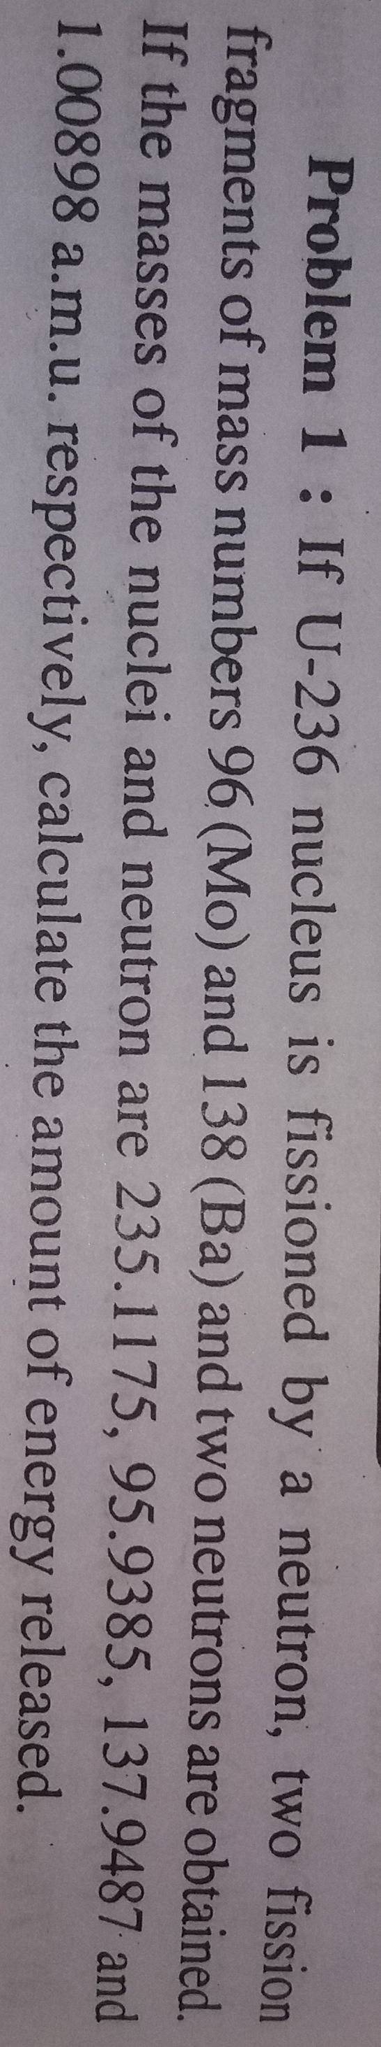

Slide 6
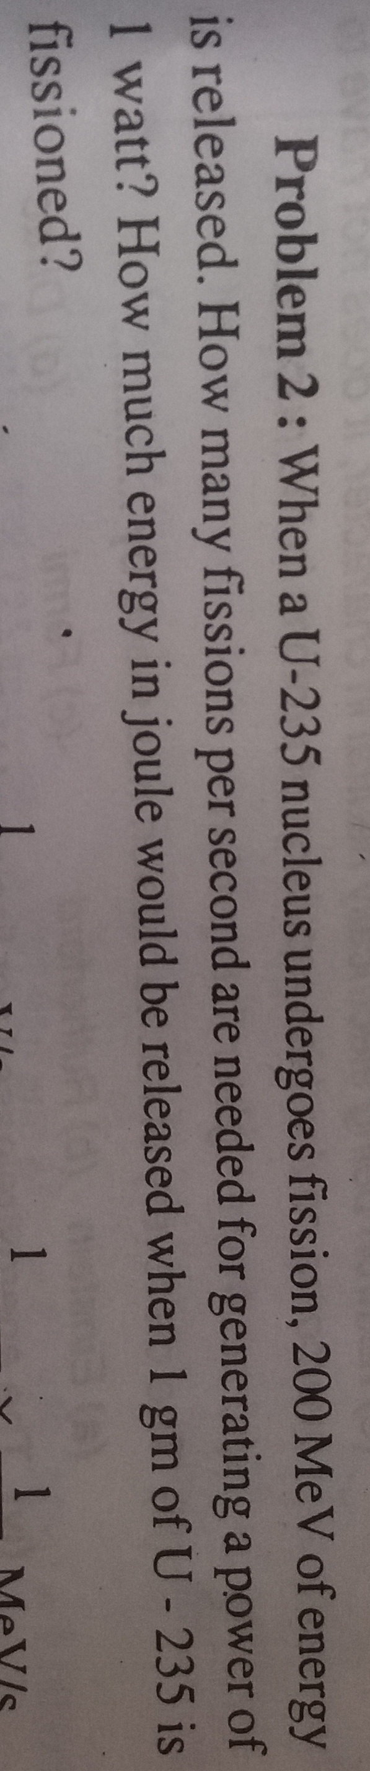

Slide 7
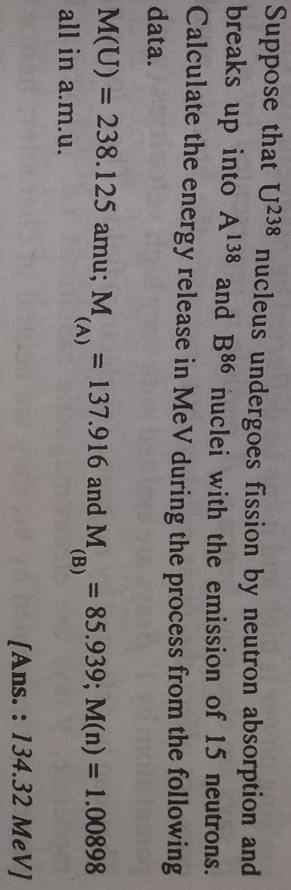

Slide 8
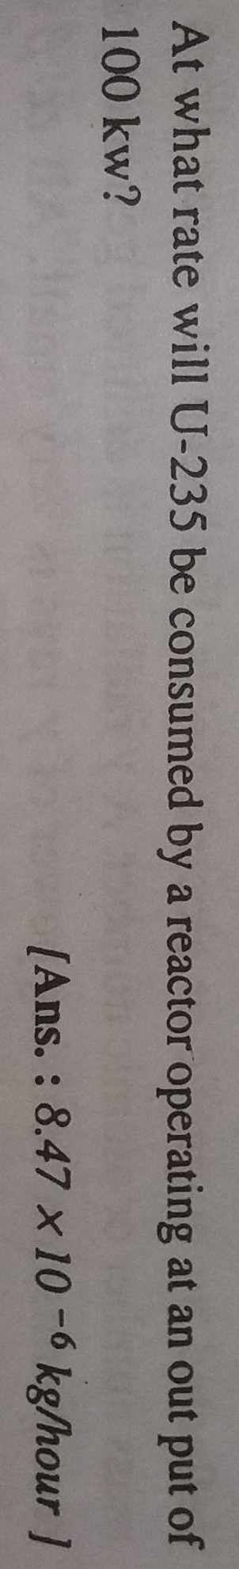

Slide 9
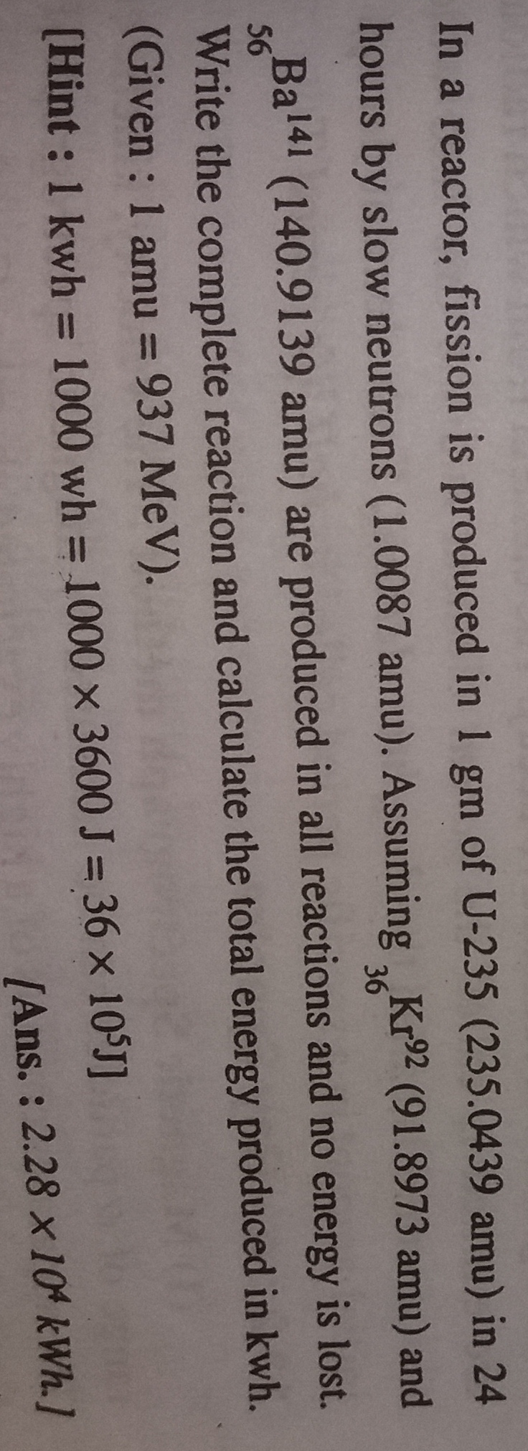

Slide 10
Thank you one and all !!!!!!!!

